Slide 1
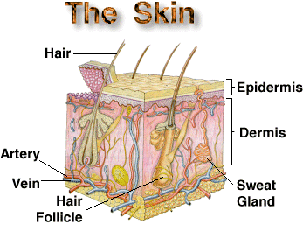
Integumentary System
Grab a Scissors, Glue stick & 3 colored pencils
Now cut out your Skin cross-section…
Skin (cutaneous membrane)
Skin derivatives
Sweat glands
Apocrine
Eccrine
Oil (sebaceous) glands
Hair
Shaft
Follicle
Nails
Label your diagram!

Slide 2
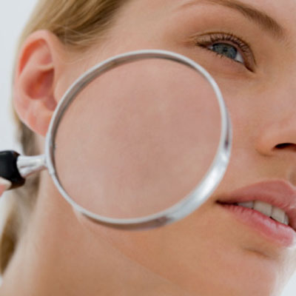
Integument (Skin) Functions
Add to the TOP of your foldable
Protects deeper tissue from:
Bumps
Chemical damage (acid & bases)
Bacterial damage
UV radiation
Thermal damage (heat/cold)
Desiccation (drying out)
Aids in:
Body heat loss & retention (controlled by NS)
Excretion of urea & uric acid (perspiration)
Synthesis of Vitamin D

Slide 3
INTEGUMENTARY SYSTEM RESEARCH PROJECT
Hair color/dye
Burns/skin grafting
Sweat dysfunctions
Botox injections
Freckles & moles
Bruising
Skin color variations/ birthmarks
Tattoos
Gauges
Scars
Permanent make-up
Facials
Face transplants
There are so many interesting, controversial & cutting-edge topics when it comes to the Integumentary System!
In replacement of an Integumentary System Exam (60 pts), you will be responsible for researching & producing a Research Project on an Integumentary topic.
- You will have multiple quizzes throughout the unit & you will see the information in the lecture notes on your Semester Exam!

Slide 4
INTEGUMENTARY SYSTEM RESEARCH PROJECT
Rubric that will be used (60 pts)…each criterion is worth 10 pts.
Define, discuss & explain the topic & its relevance/ importance to the Integumentary System using anatomical/Integumentary terminologies
Works Cited in MLA Format with Proper Research Citation
Minimum of 5 graphics (must pertain to topic)
Minimum of 2 statistical analyses via graph or raw data
Solo OR partners actively participated in research & project
A 5 question Quiz (Multiple Choice, Fill-in &/or Identification) turned in with Research Project

Slide 5
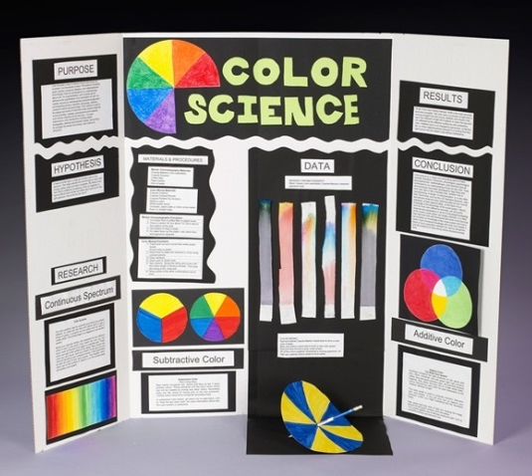
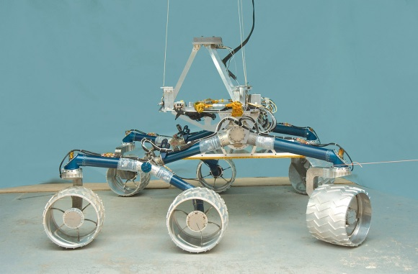
INTEGUMENTARY SYSTEM RESEARCH PROJECT
FORMAT of Project:
Physical model
Billboard display
Brochure/pamphlet
Video
Skit/play
Any other format EXCEPT a PowerPoint/ Prezi presentation
GET CREATIVE!!!!

Slide 6
INTEGUMENTARY SYSTEM RESEARCH PROJECT
REMEMBER: This is your INTEGUMENTARY SYSTEM EXAM grade!
There will be NO IN-CLASS WORK TIME dedicated, so it will also require out-of-class work time!
Decided whether you would like to work with a partner or solo. Stand/sit next to your partner, if you have one.
I’m going to make my way around with my “Can o’ Topics”.
Please pick 1!
Write your TOPIC on your RUBRIC!
Exchange phone numbers &/or e-mails so you can contact each other about meeting & dividing up work!

Slide 7
Integumentary System
Grab a Scissors, Glue stick & 3 colored pencils
Now cut out your Skin cross-section…
Skin (cutaneous membrane)
Skin derivatives
Sweat glands
Apocrine
Eccrine
Oil (sebaceous) glands
Hair
Shaft
Follicle
Nails
Label your diagram!

Slide 8
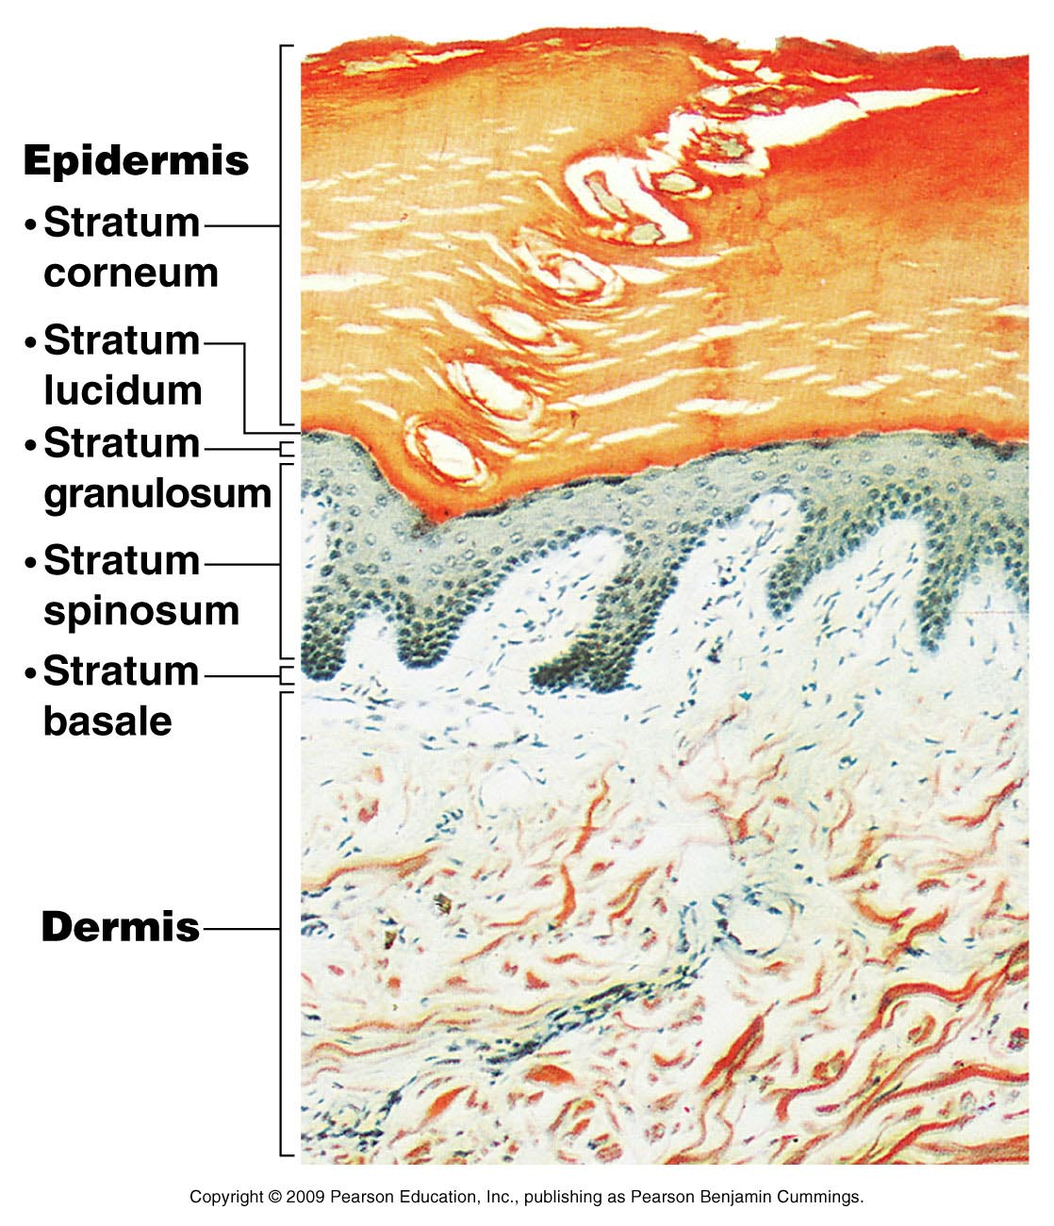
Skin Structure
Epidermis—outer layer
Stratified squamous epithelium
Consists of 4-5 distinct layers
Often keratinized (hardened by keratin)
Not vascular
Regenerated every 25-45 days
Dermis
Dense connective tissue
Subcutaneous tissue (hypodermis) is deep to dermis
Not part of skin
Anchors skin to underlying organs
Composed mostly of adipose tissue (fat)
Add these
tidbits
to the area
BEHIND each flap!

Slide 9
Layers of the Epidermis
Per. 3 - Mon
From deepest to most superficial
Stratum basale
Deepest layer of epidermis
Cells undergoing mitosis
Daughter cells pushed upward to become more superficial
Stratum spinosum
Stratum granulosum
Stratum lucidum
Formed from dead cells of deeper strata
Occurs only in thick, hairless skin of palms of hands & soles of feet
Stratum corneum
Dead cells are filled with keratin (protective protein prevents water loss from skin)
Write this in the
Epidermis flap!

Slide 10
Layers of the Epidermis
Per. 1 - Mon
From most superficial to deepest
Stratum corneum
Stratum lucidum
Stratum granulosum
Stratum spinosum
Stratum basale
Color-code your diagram –
1 color for each strata of the epidermis!
Can you come up with a Mnemonic to remember the layers?

Slide 11
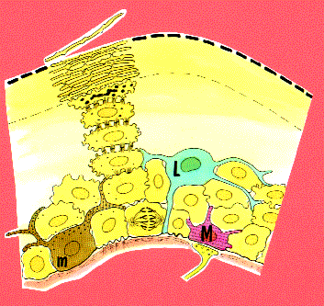
Per. 2, 4 - Mon
Layers of the Epidermis
4 Types of Cells:
Keratinocytes
Produce keratin, the fibrous protein that helps give the epidermis its protective properties
Melanocytes
Synthesize pigment called melanin
Melanin picked up by keratinocytes & used to shade their nuclei from UV radiation
Merkel cells
Combo of Merkel cell & nerve ending (called Merkel disc) functions as a sensory receptor for touch
Langerhans’ cells
Macrophages that help to activate immune system

Slide 12
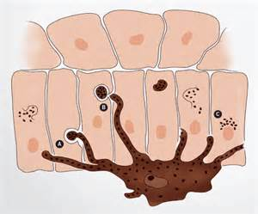
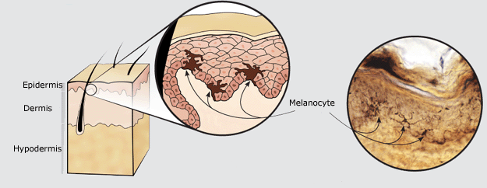
Color in the Epidermis
Normal Skin Color Determinants
Melanin:
Pigment (melanin) produced by melanocytes
Melanocytes are mostly in the stratum basale
Color is yellow to brown to black
Amount of melanin produced depends upon genetics & exposure to sunlight (UV)

Slide 13
Epidermis Review
What are the major characteristics of the Epidermis?
What are the 4 types of cells found within the Epidermis & their functions?
What are the 5 layers (strata) of the Epidermis from deep to superficial?

Slide 14
Where’s this Headed?
What is the picture below called?
Which of these forms of electromagnetic radiation are most effected by the Integumentary System?
What are some precautions we can take to protect our Int. Sys. from UV radiation?
What does “SPF” stands for & how does it work?
How do we know these precautions actually work?
Do our bodies’ have a natural defense against UV?

Slide 15
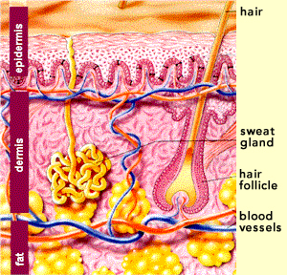
Dermis
Add this info to your
Foldable!
Strong, flexible connective tissue
Cell types:
Fibroblasts
Macrophages
Mast cells
White blood cells
Binds the entire body together
Your HIDE
Innervated (nerves) & vascularized (blood)
Hair follicles, oil glands & sweat glands
2 major layers:
Papillary layer
Reticular layer

Slide 16
Layers of the Dermis
Keep writing!
Papillary Layer
Highly vascularized
Borders the stratum basale of epidermis
Superior portion covered with dermal papillae, which house blood capillaries
Touch & pain receptors
On palms & soles, these papillae lie atop dermal ridges, which produce whorled epidermal ridges (fingerprints)

Slide 17
Layers of the Dermis
One more slide
for Dermis!
Reticular Layer
Deep to papillary layer
~80% of dermis
Made up of dense irregular connective tissue (matrix consist of high quantities of collagen fibers)
Helps dermis from being easily penetrated
Collagen binds water, helping to hydrate the skin
Elastin fibers give skin elasticity

Slide 18
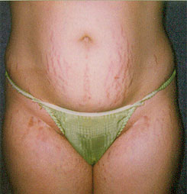
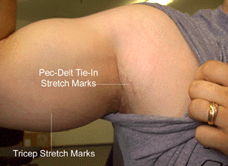
Other Stuff about the Dermis
Flexure lines
Extreme stretching of skin can tear dermis (stretch marks) - striae
Short-term trauma can cause a blister to form (fluid sac that forms between epidermis & dermis)
Flexure lines – dermal folds that occur at or near joints where dermis is tightly attached to deeper underlying structures
Last slide
under Dermis!

Slide 19
Hypodermis
Add this info to your Foldable
under Hypodermis!
Known as subcutaneous tissue or superficial fascia
Structure:
Has more adipose than dermis
Functions:
Energy reservoir
Thermal insulation
Hypodermic injections
Into subcutaneous tissue since highly vascular
Hypodermis

Slide 20
Hypodermal (subcutaneous) fat distribution
Mid-section
Outer thighs
Buttocks
Breasts
Why is
there
more fat
in
these
areas?

Slide 21
Color in the Dermis & Hypodermis
Add this info to
your Foldable
for Dermis/
Hypodermis!
Normal Skin Color Determinants
Carotene:
Yellow-orange pigment found in certain plant products
Accumulates in stratum corneum & in adipose tissue of hypodermis
Most obvious in palms & soles where S. corneum is thickest

Slide 22
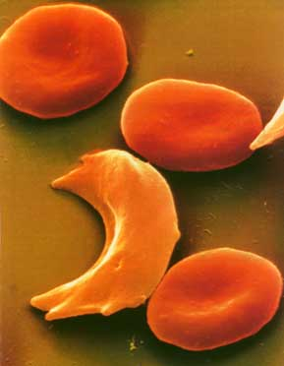
Color in the Dermis & Hypodermis
Add this info to
your Foldable
for Dermis/
Hypodermis!
Normal Skin Color Determinants
Hemoglobin:
Red pigment of red blood cells (RBCs)
Since Caucasian people contain relatively small amounts of melanin, their skin is nearly transparent which allows hemoglobin’s color to shine through

